Slide 1

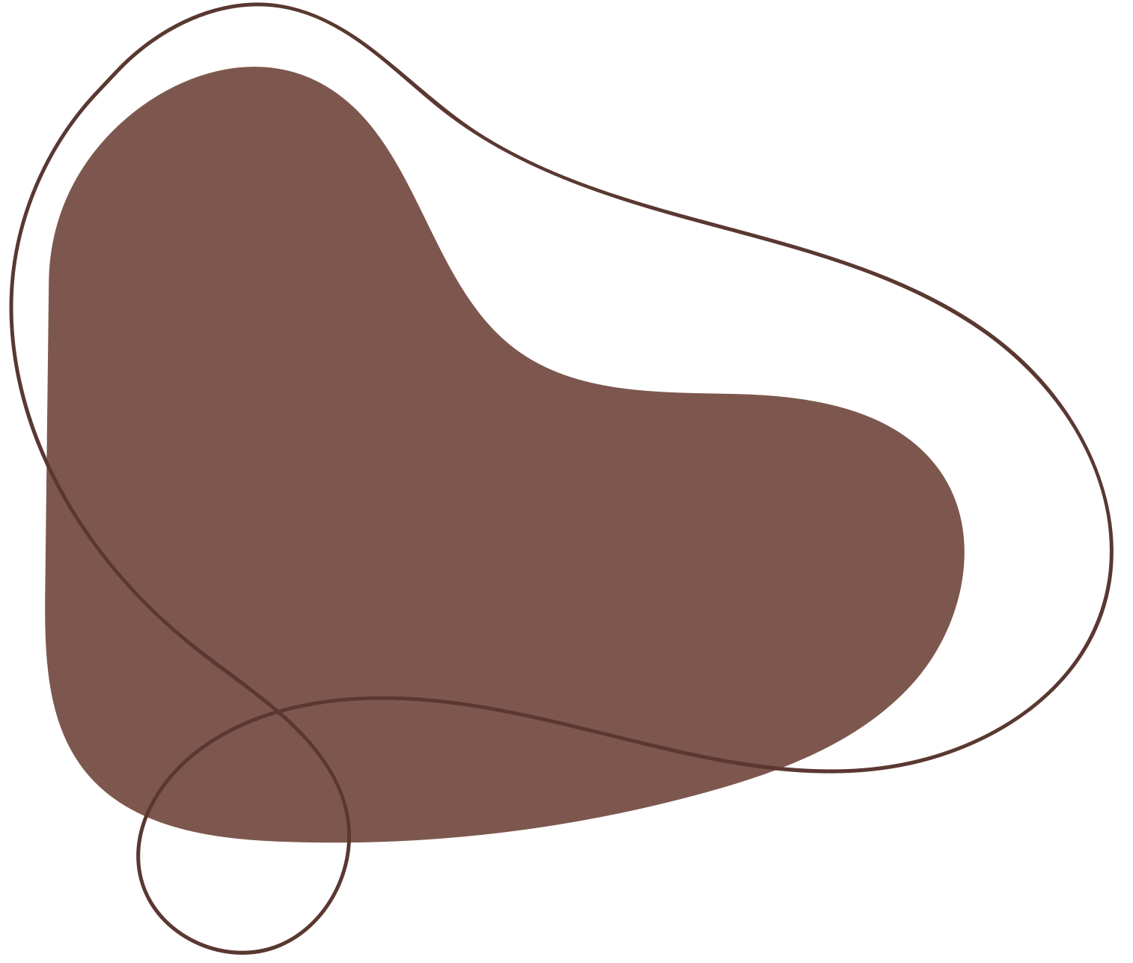
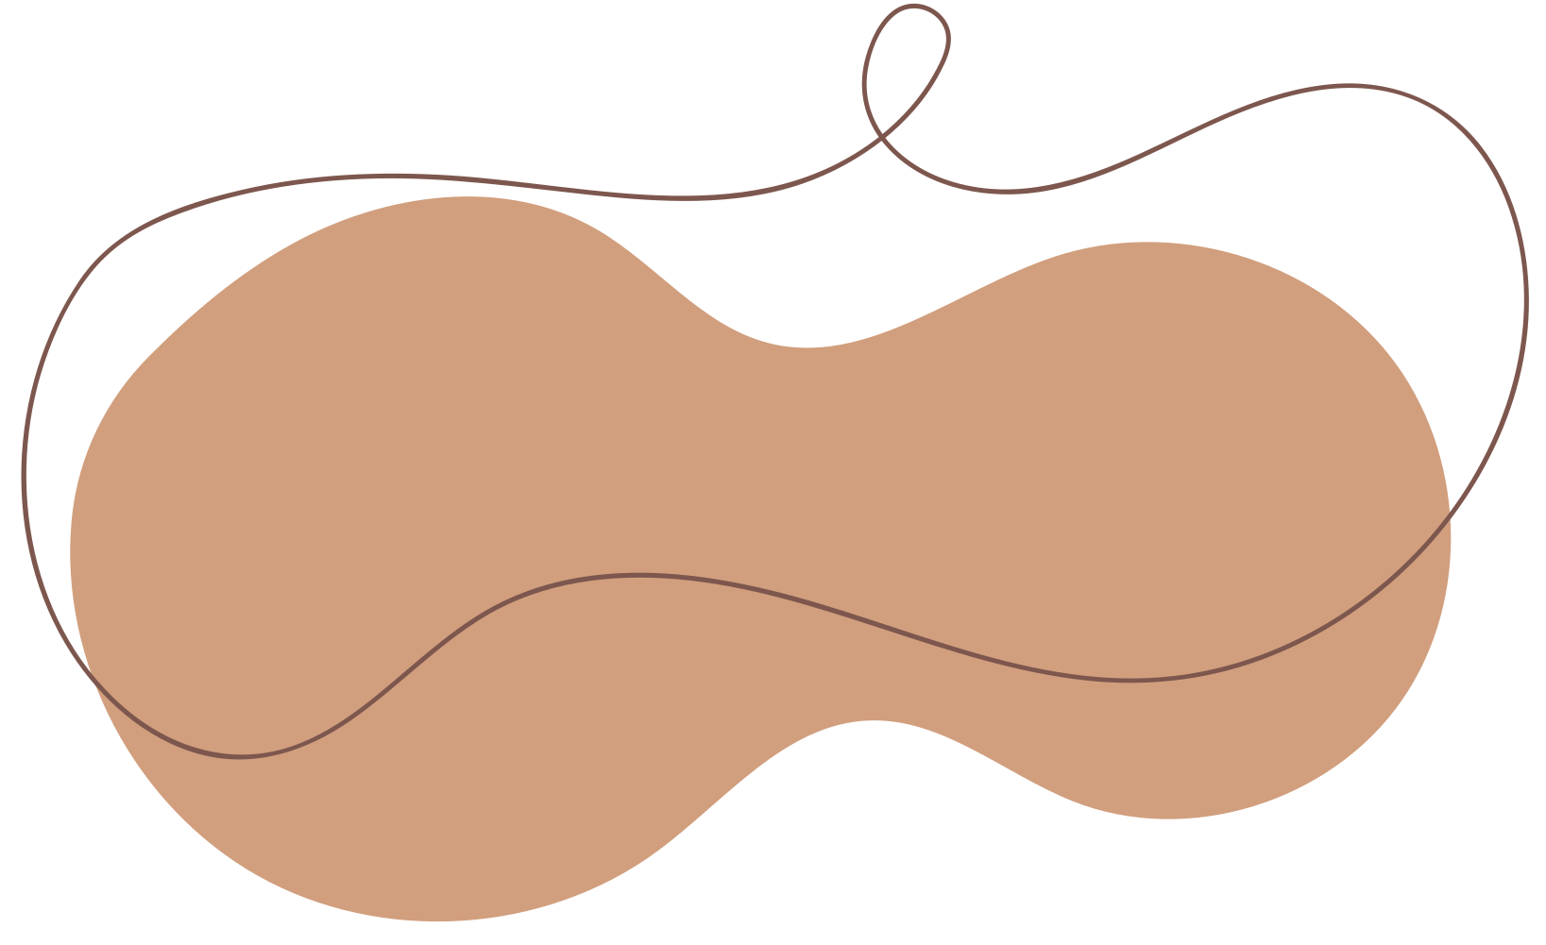



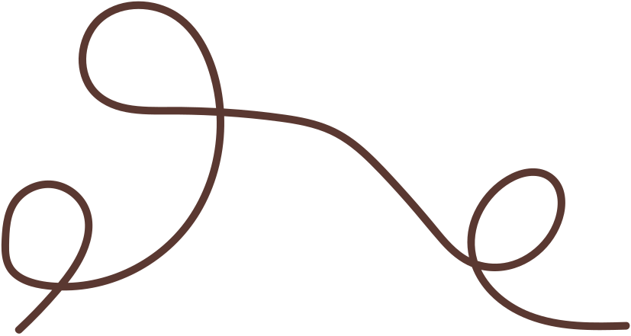

Drawn System – Digital Commission Platform
Connecting Artists and Buyers Seamlessly

Slide 2
System Inspiration
The Drawn System was inspired by the need for a streamlined platform that bridges the gap between artists and buyers. Traditionally, commissioning artwork involves scattered communications and manual tracking of requests, offers, and deliverables. This system centralizes these processes, ensuring clarity, efficiency, and accountability. It provides a secure, role-based environment where users can interact seamlessly and manage their transactions with ease.

Slide 3
Introduction
Drawn System is a console-based application that supports three main roles: Admin, Artist, and Buyer. The system ensures that the first admin is created at setup, providing governance from the start. Each role has a tailored dashboard with functionalities designed to match their needs. Admins oversee users, offers, and commissions; artists can browse open commissions, submit offers, and upload artwork; buyers can create commissions, track offers, and view delivered artworks.

Slide 4
Stakeholders Overview
  Admin: Manage users, view offers, monitor commissions
  Artist: Submit offers, upload artworks, track accepted commissions
  Buyer: Create commissions, accept/reject offers, view delivered artworks

Slide 5
Stakeholders – Actions Table
RoleKey Actions
Admin: Add/Update/Delete Users, Approve/Check Commissions, View Offers
Artist: View Open Commissions, Submit Offers, Upload & View Artworks
Buyer: Create Commission, View Offers, Accept/Reject, Track Deliveries

Slide 6
ERD Overview
The system revolves around four core entities: User, Commission, Offer, and Artwork. Users can be admins, artists, or buyers, each with distinct roles. Artists submit offers for commissions and upload completed artwork linked to those commissions. Buyers create commissions and evaluate offers. Admins oversee all entities, providing governance and ensuring system integrity.

Slide 7
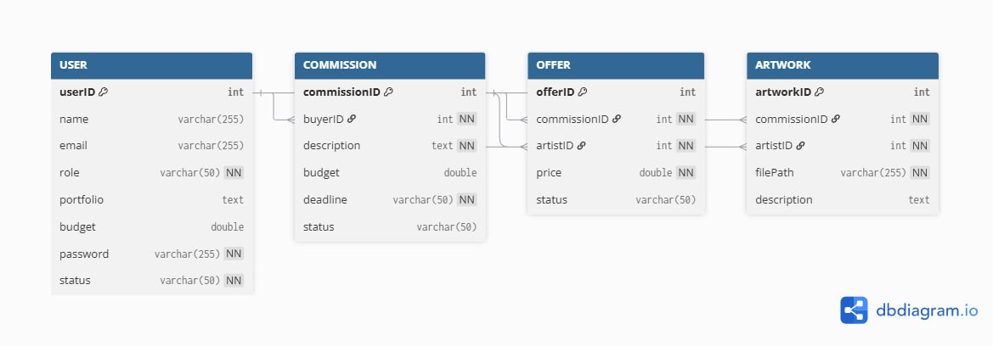
ERD Visual

Slide 8
Flowchart Overview
The main flow starts with system initialization and admin check, followed by the main menu offering login or registration. Users are then redirected to dashboards based on their roles: Admin, Artist, or Buyer. Each dashboard provides access to functions relevant to the role while maintaining security and data integrity.

Slide 9
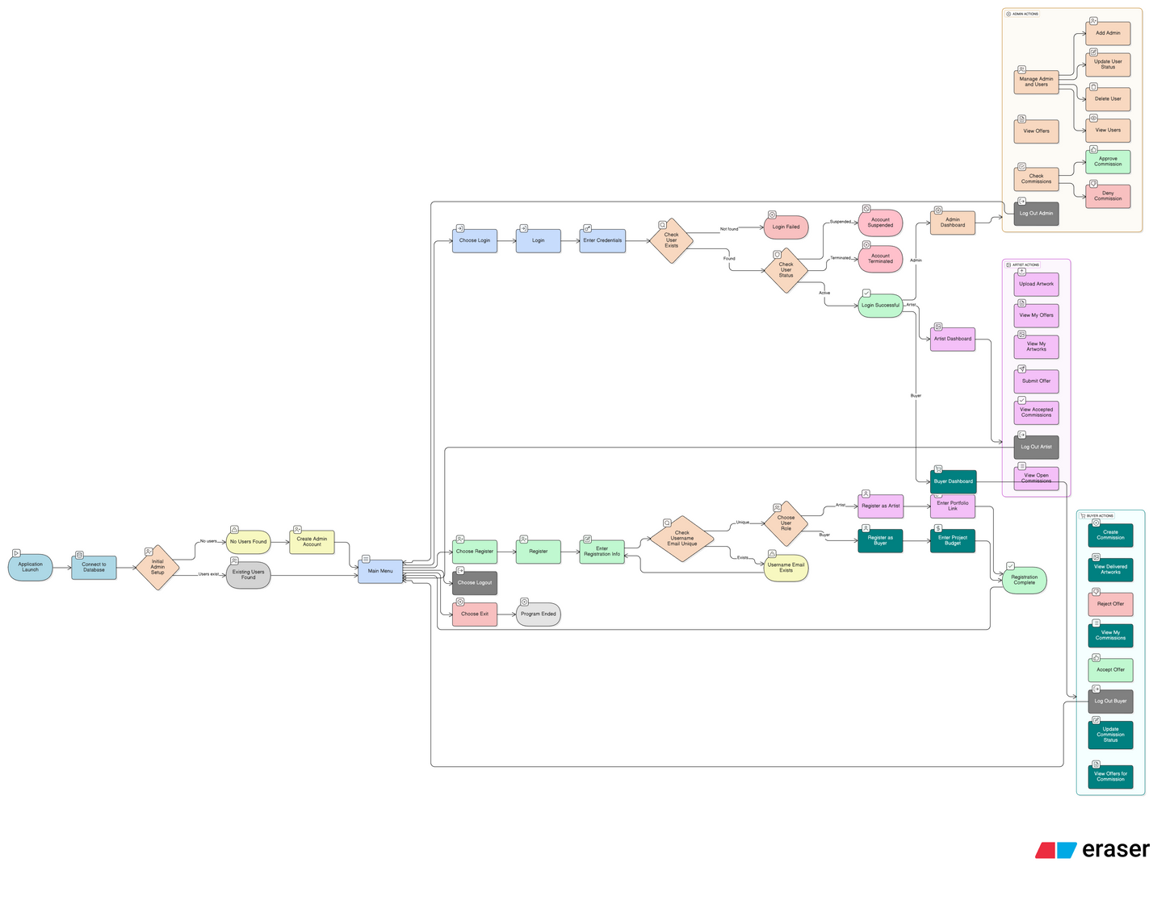
Flowchart Visual

Slide 10
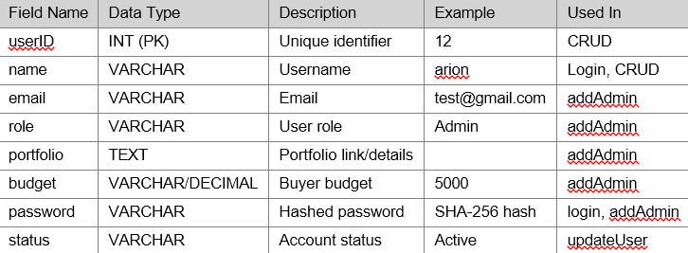
Data Dictionary
User Table:

Slide 11
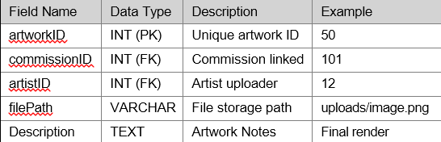
Data Dictionary
Artwork Table:

Slide 12
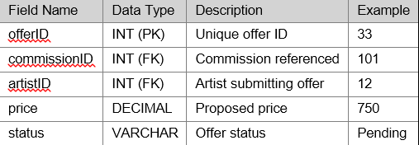
Data Dictionary
Offer Table:

Slide 13
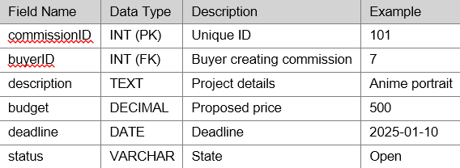
Data Dictionary
Commission Table:

Slide 14
System Features – Admin
Admins can add, update, or delete users, view offers, and approve or deny commissions. These functions provide governance over all system interactions and ensure integrity across all transactions.

Slide 15
System Features – Artist
Artists can browse open commissions, submit offers, track accepted commissions, and upload or view artworks. These features streamline the workflow from commission discovery to delivery of the completed artwork.

Slide 16
System Features – Buyer
Buyers create commissions, view offers, accept or reject submissions, update commission status, and track delivered artworks. This empowers buyers to maintain control and transparency over their commissioned projects.

Slide 17
Program Demonstration – Core Functions
The system uses console-based dashboards that guide users through role-specific operations. Admins, artists, and buyers all have tailored menus with clear, tabular outputs for Users, Offers, Commissions, and Artworks.

Slide 18
Program Demonstration – Security & Validation
The system incorporates password hashing and role-based access. Validation ensures unique usernames and emails, correct input types, and proper status assignments. Suspended or terminated accounts cannot access restricted functions, maintaining security.

Slide 19
Program Demonstration – Reports
All outputs are displayed in tabular form for clarity. Reports include users, offers, commissions, and artworks, enabling easy review and printing if needed.

Slide 20
System Evaluation / Reflection
Developing the Drawn System presented challenges including secure authentication, handling relational data, and designing role-based dashboards. Key learnings involved input validation, modular coding, and maintaining access control. Future improvements could include a GUI interface, notifications for offer status, integrated analytics for admins, and better file storage for artworks.

Slide 21
Thank
You

